Slide 1
Durant High School athletics Paperwork directions

Slide 2
List of Documents Needed For Athletic Clearance
EL2 (Physical) on new approved FHSAA EL2 form (3/23)
Birth Certificate
2 Proofs of Residence (teco/water bill within 30 days of athletic clearance application, If using lease student MUST be listed as an occupant)
3 FHSAA Required Videos
Government Issued ID of parent signing forms
School Health of Florida Insurance ID card

Slide 3
Documents required #1 physical
Prior to starting, you will need the following documents
FHSAA EL2 Physical - use NEW FHSAA EL2 on SDHC Athletics website -https://www.sdhc.k12.fl.us/doc/list/athletics/student-forms/39-285/
MUST be on this form. Physicals are good for 365 days
ONLY PAGE 4 MUST BE UPLOADED unless student not cleared without limitations
MUST include doctor’s stamp, signature, printed name and date on page 4.
Make sure the CLEARED WITHOUT LIMITATIONS box has been checked by your physician.
If not cleared without limitations – you WILL NEED page 5 (SUPPLEMENT) of the EL2. This is the clearance and will need to be marked cleared without limitations after the visit to the referred doctor/specialist
Upload page 4 ONLY IF CLEARED WITHOUT LIMITATION. If recommendations were made and student athlete was referred page 5 will need to be uploaded.
Page must be filled out completely in order for EL2 to be valid.

Slide 4
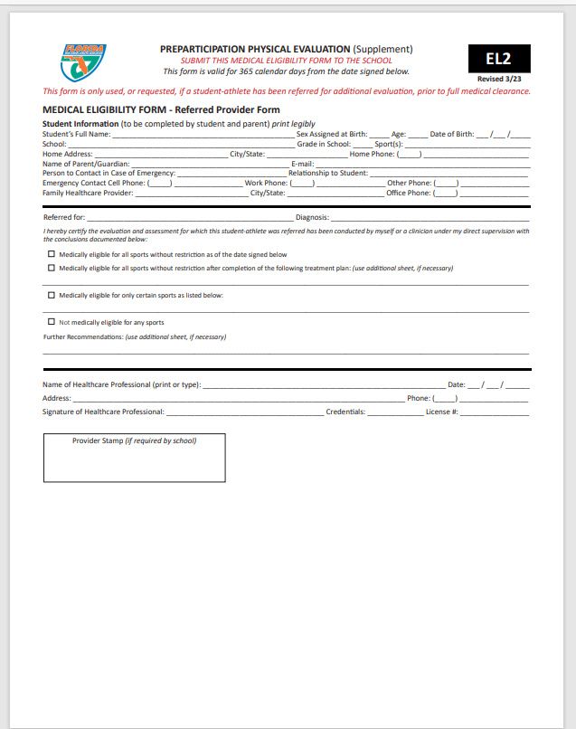
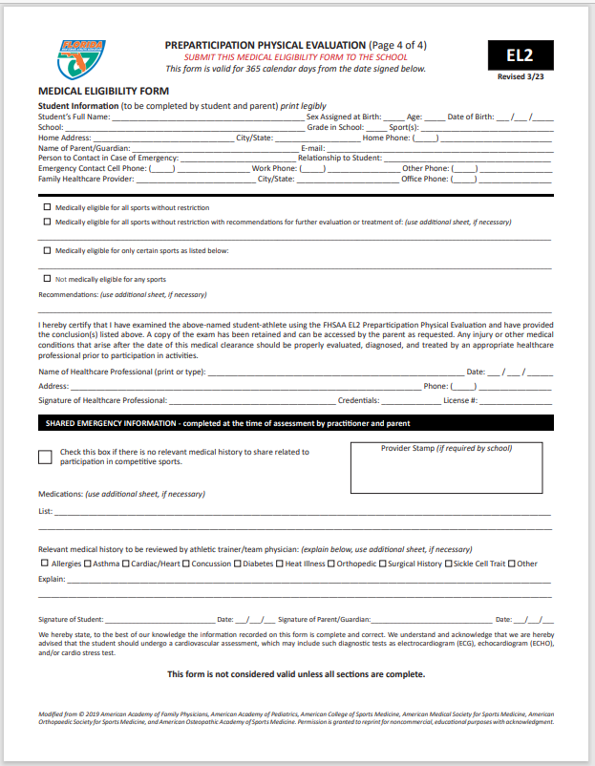
Student’s Information MUST be completed at the TOP!
Doctor’s Name MUST be Printed
Doctor’s Signature & Date
Doctors Office Address and Phone # (Or Stamp)
Credentials
License #
This section is if you need to let our Certified Athletic Trainer (ATC) know any pertinent information. Check No if no pertinent information. Information such as allergy, asthma can go here so our ATC is aware.
Only Necessary if Recommendations were made on page 4 and form MUST be completed by specialist listed on recommendation/precaution etc…
Student and parent signature and date

Slide 5
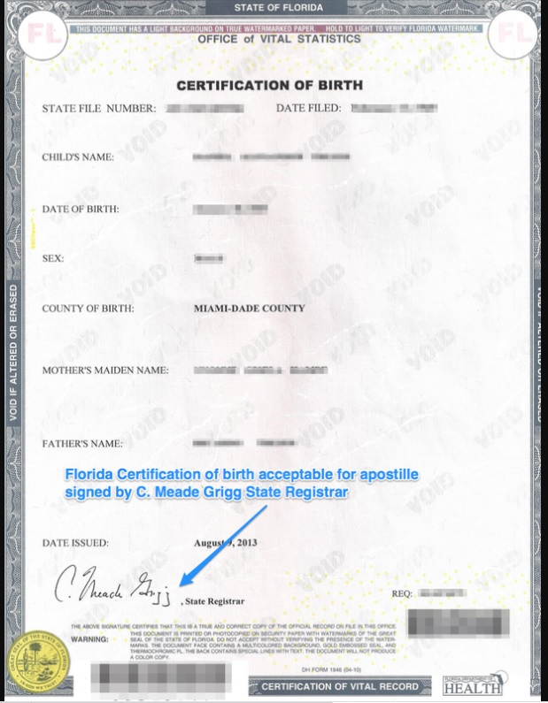
Documents required #2 certified copy of student athlete’s birth certificate

Slide 6
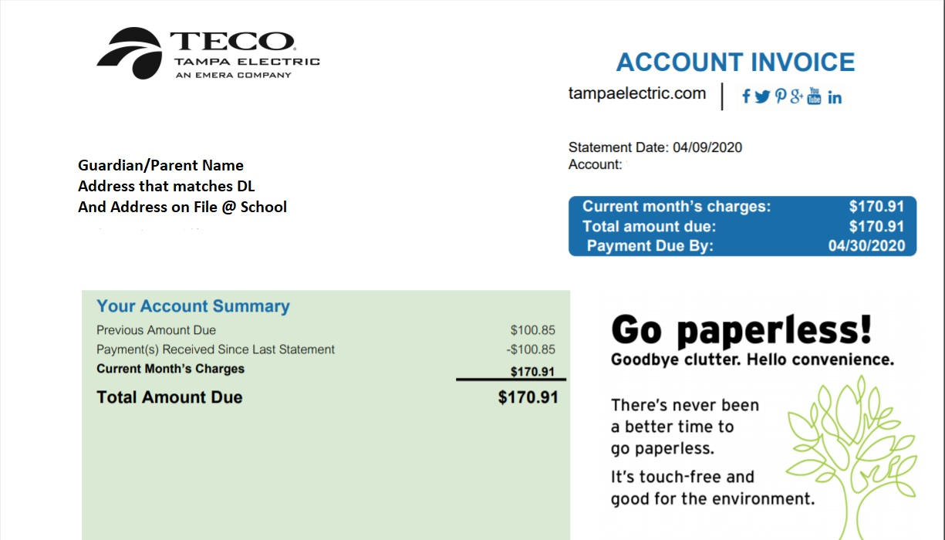
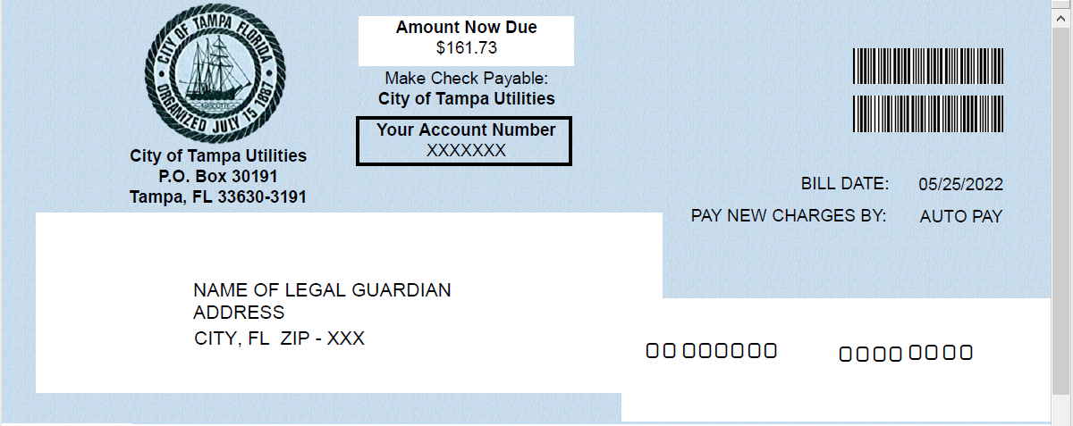
Documents required #3 (2) proofs of residence
MUST be “living proof”
MUST be within 30 days of application
Address MUST match address on government issued ID and address on file at school
Examples: (Acceptable proofs of residence):
Teco Bill
Water Bill
Lease (with occupants listed)
Mortgage Statement
Not Accepted:
Cable Bill
Phone Bill
CC Bill

Slide 7
Documents required #4: FHSAA Video certificates
Viewing the videos is required each year. For the 2023-24 school year, videos must be viewed AFTER May 15, 2023.
www.nfhslearn.com
Have the student log in or create an account. Be sure when asked for the name on the certificate the STUDENT’S NAME is entered and NOT the parent. The student is responsible for watching the videos, not the parent.
Order the following courses (they are FREE). Once you have completed checkout, the student can access the courses in their Dashboard.
Concussion in Sports – What You Need to Know
Heat Illness Prevention
Sudden Cardiac Arrest
Once the student has completed all three courses, download the certificates.
Use the upload tips for multiple pages to upload the certificates.

Slide 8
Documents required #2 FHSAA VIDEO Certificates
Certificates for the three required FHSAA videos (in student’s name) from nfhslearn.com.
Upload each certificate in the appropriate places in the files section.
Videos must be completed after May 15, 2023 of the current year to be accepted for the 2023-2024 school year

Slide 9
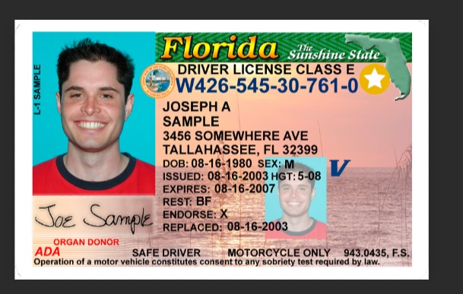
Documents required #5 government issued id
Government issued photo identification of parent or legal guardian signing the forms.
Address MUST match address on file and proof of residence for athletic clearance
When scanning this document, make sure all information is clearly visible in the picture.

Slide 10
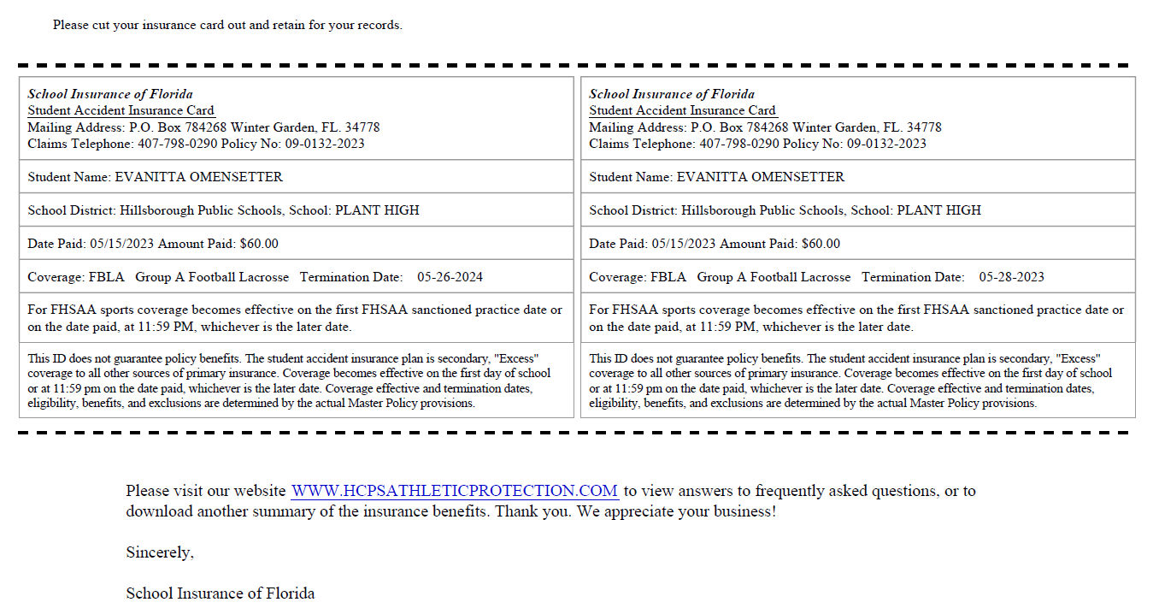
Document # 6: Insurance id card
Log into your school insurance of Florida account (https://hcpsathleticprotection.com/)
Download/print and/or Save your insurance ID card provided after purchase.
Upload to your athletic clearance account

Slide 11
DOCUMENT CHECKLIST:
Before logging in or creating an account on athletic clearance make sure you have all the following
List of Documents Needed For Athletic Clearance
EL2 (Physical) on approved FHSAA EL2
Birth Certificate
Two (2) Proof of Residence
Eg: (teco or water bill within 30 days of athletic clearance application)
Mortgage
Lease (Student MUST be listed as an occupant)
Homestead ONLY Property Record
3 FHSAA Required Videos
Government Issued ID of parent signing forms
School Health of Florida Insurance ID card

Slide 12
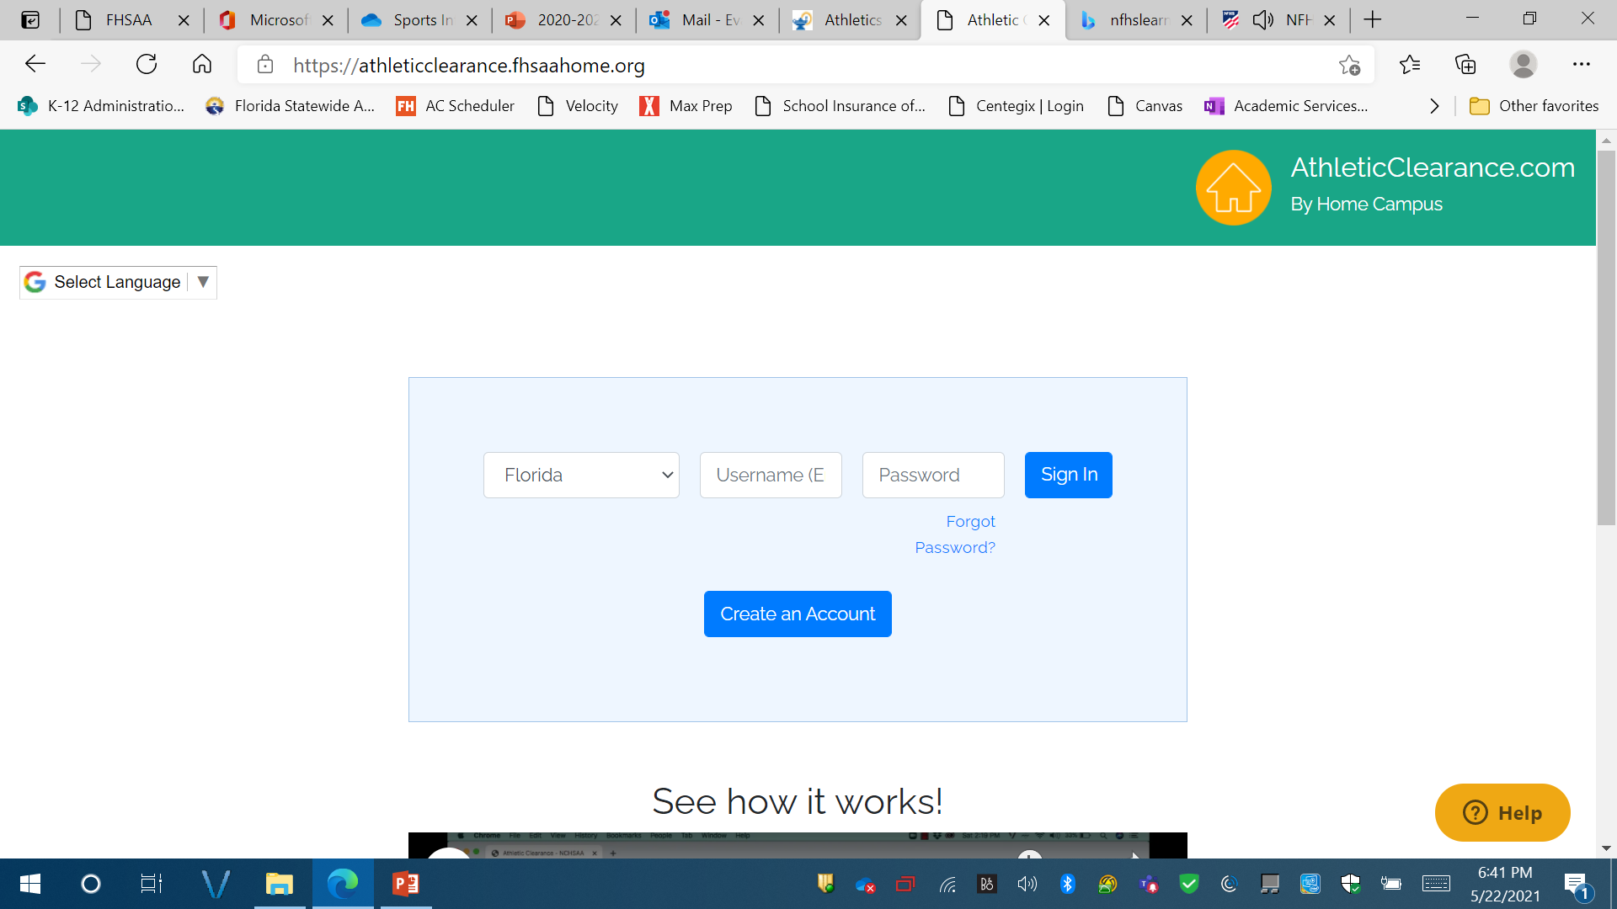
Logging In
https://athleticclearance.fhsaahome.org/
If you have ever had an account, log in here. If you have forgotten your info, DO NOT create a new account. Use the reset or HELP options.
If you have never logged in – click here to create an account.
The parent must create the account using THEIR email, not the student’s.

Slide 13
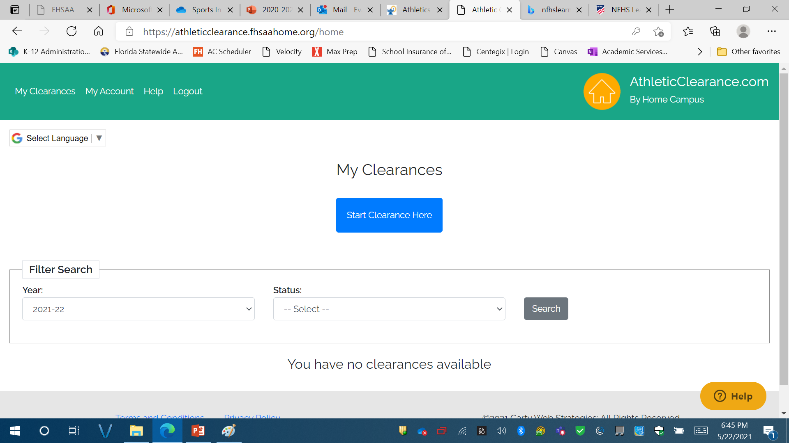
After Logging In
Click “Start Clearance Here”

Slide 14
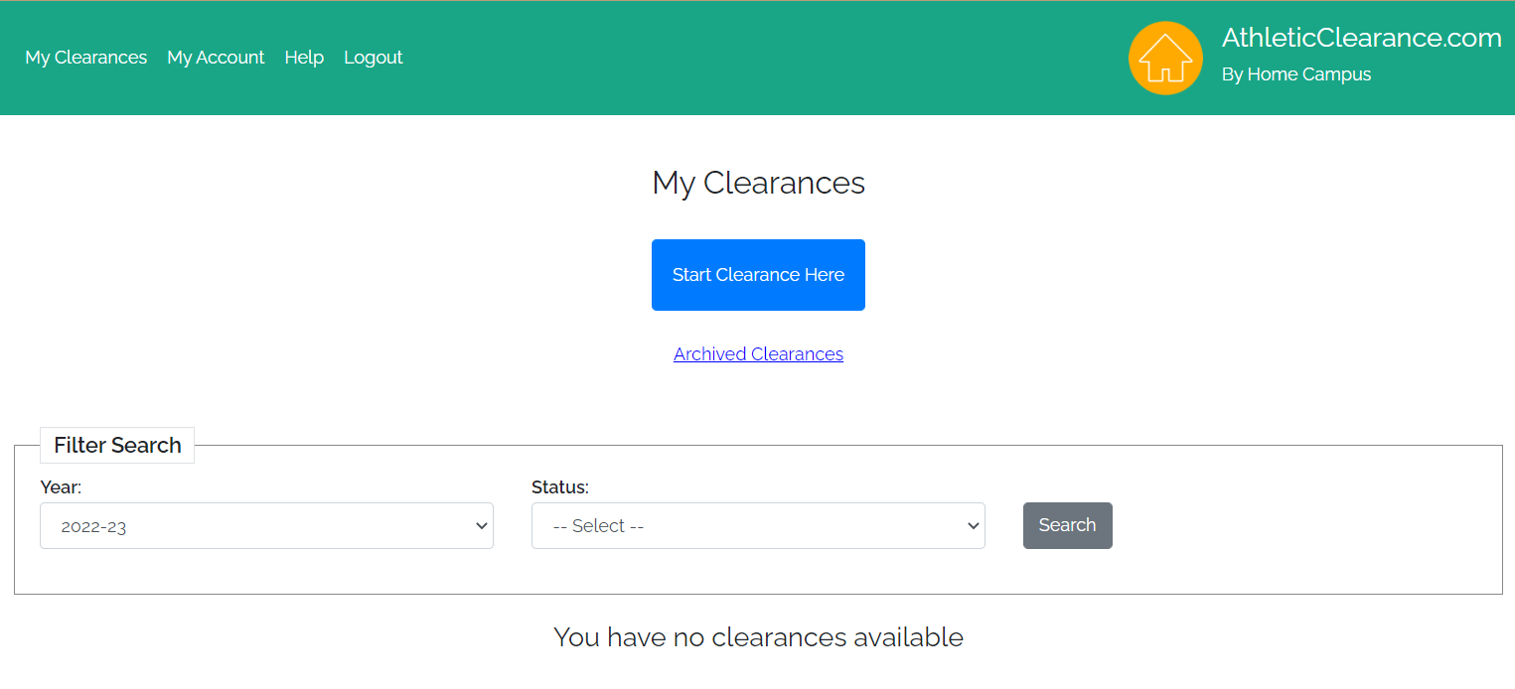
Select school Year
Choose 2023-24

Slide 15
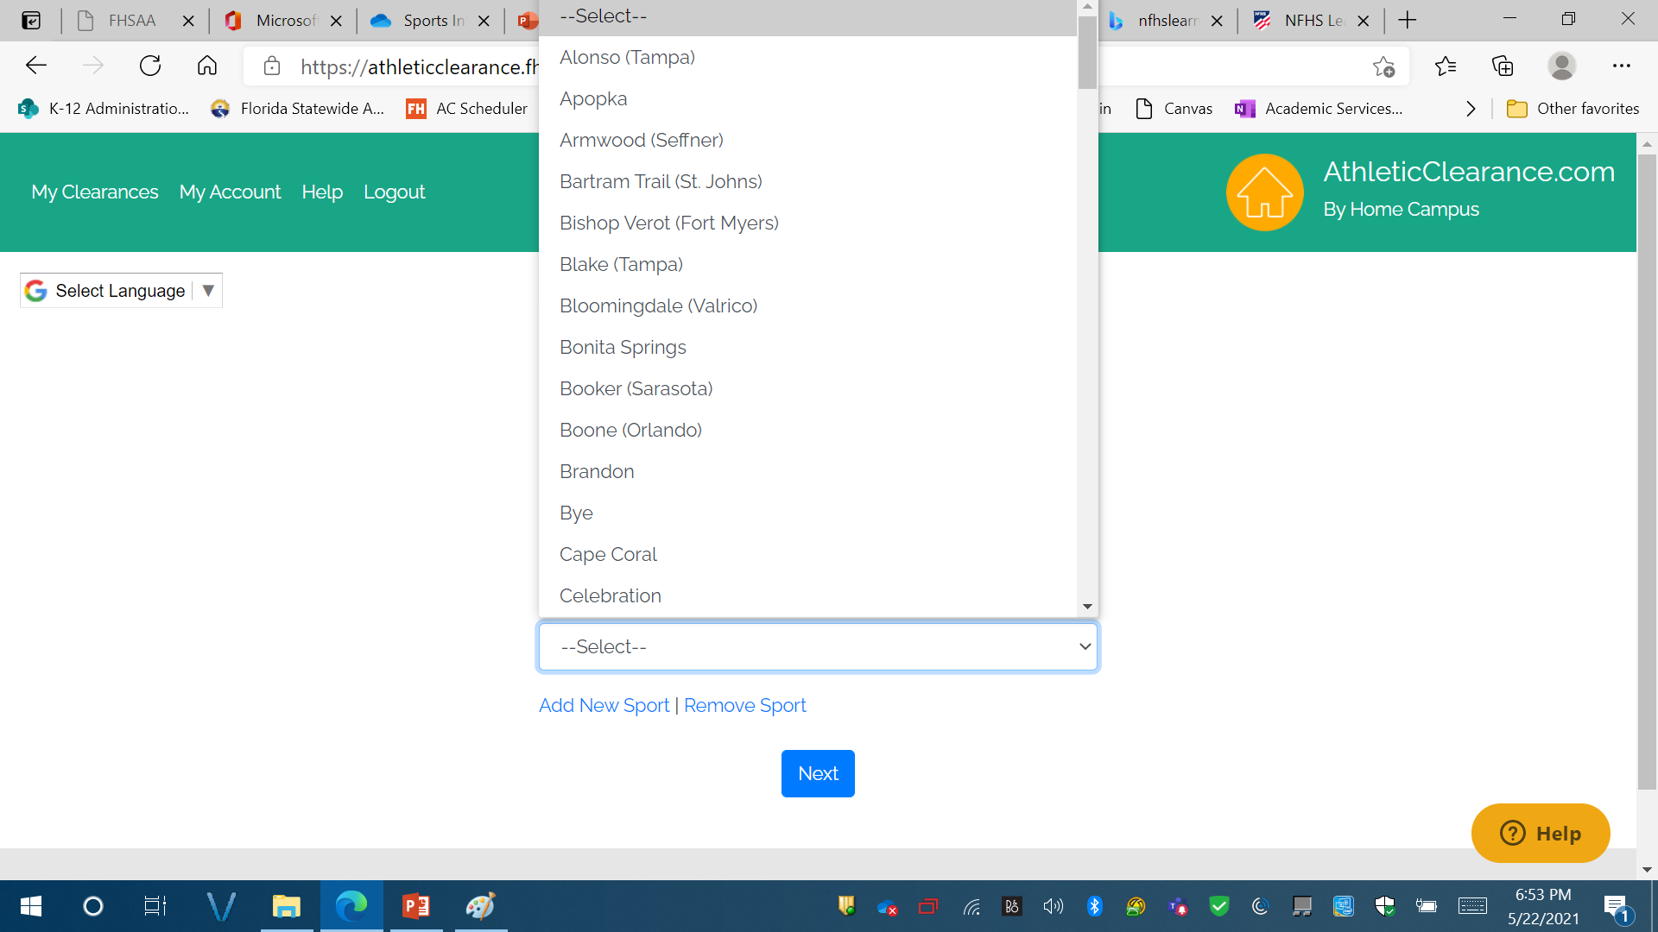
Select school
Scroll and Choose Plant High School

Slide 16
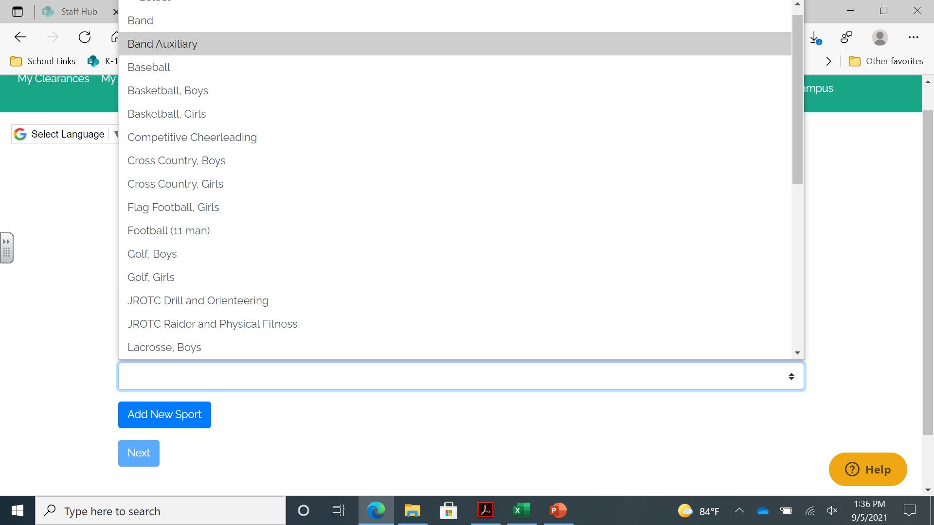
Select Sport
Choose Sport

Slide 17
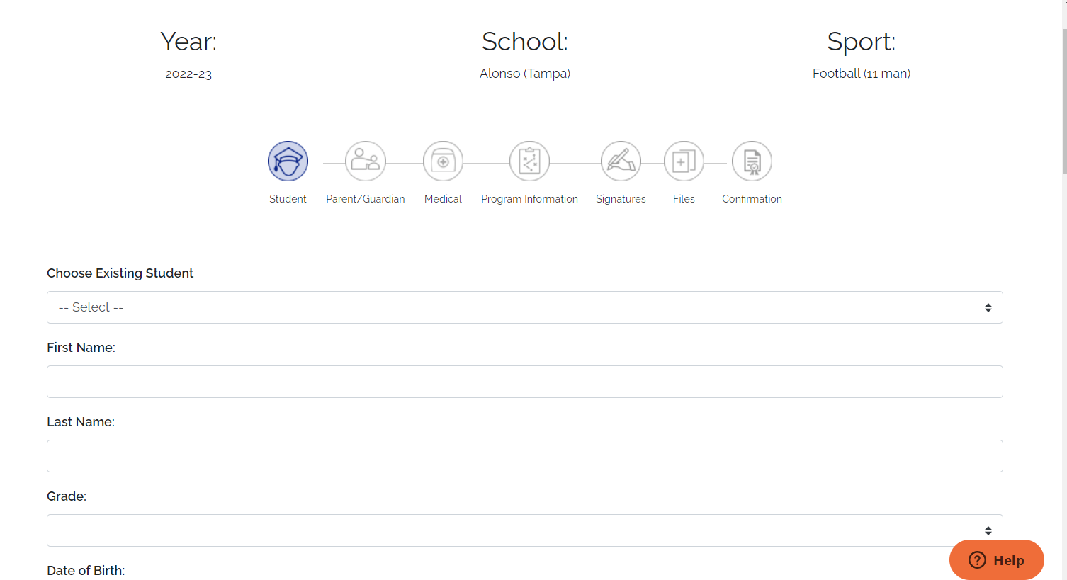
If you are an existing student select your name from the drop down.
Note: This is a form of communication, the more accurate it is the better we can communicate.
If you are a new student start entering your information, click save and continue

Slide 18
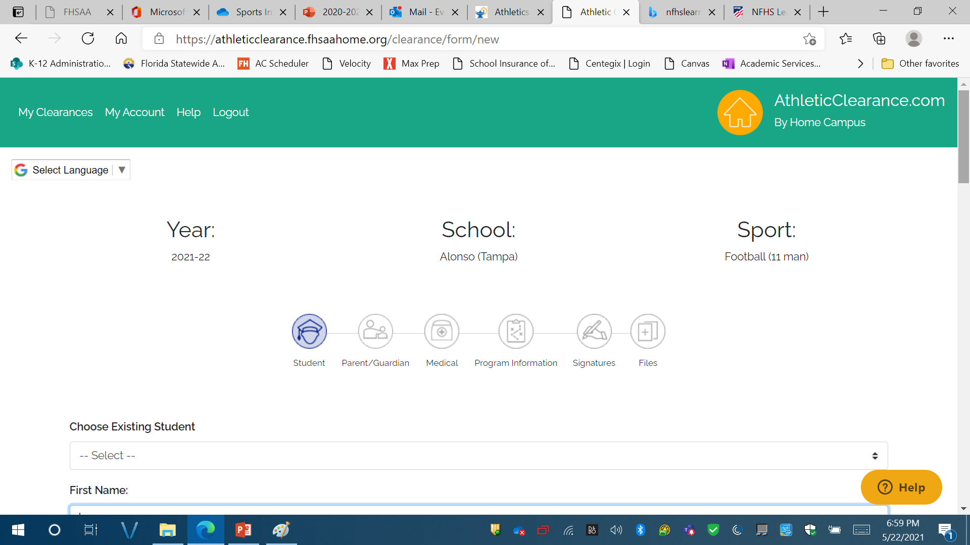
Student Information
This page is for information about your STUDENT.
Complete the form and click on save and continue
Accurate information is needed here

Slide 19
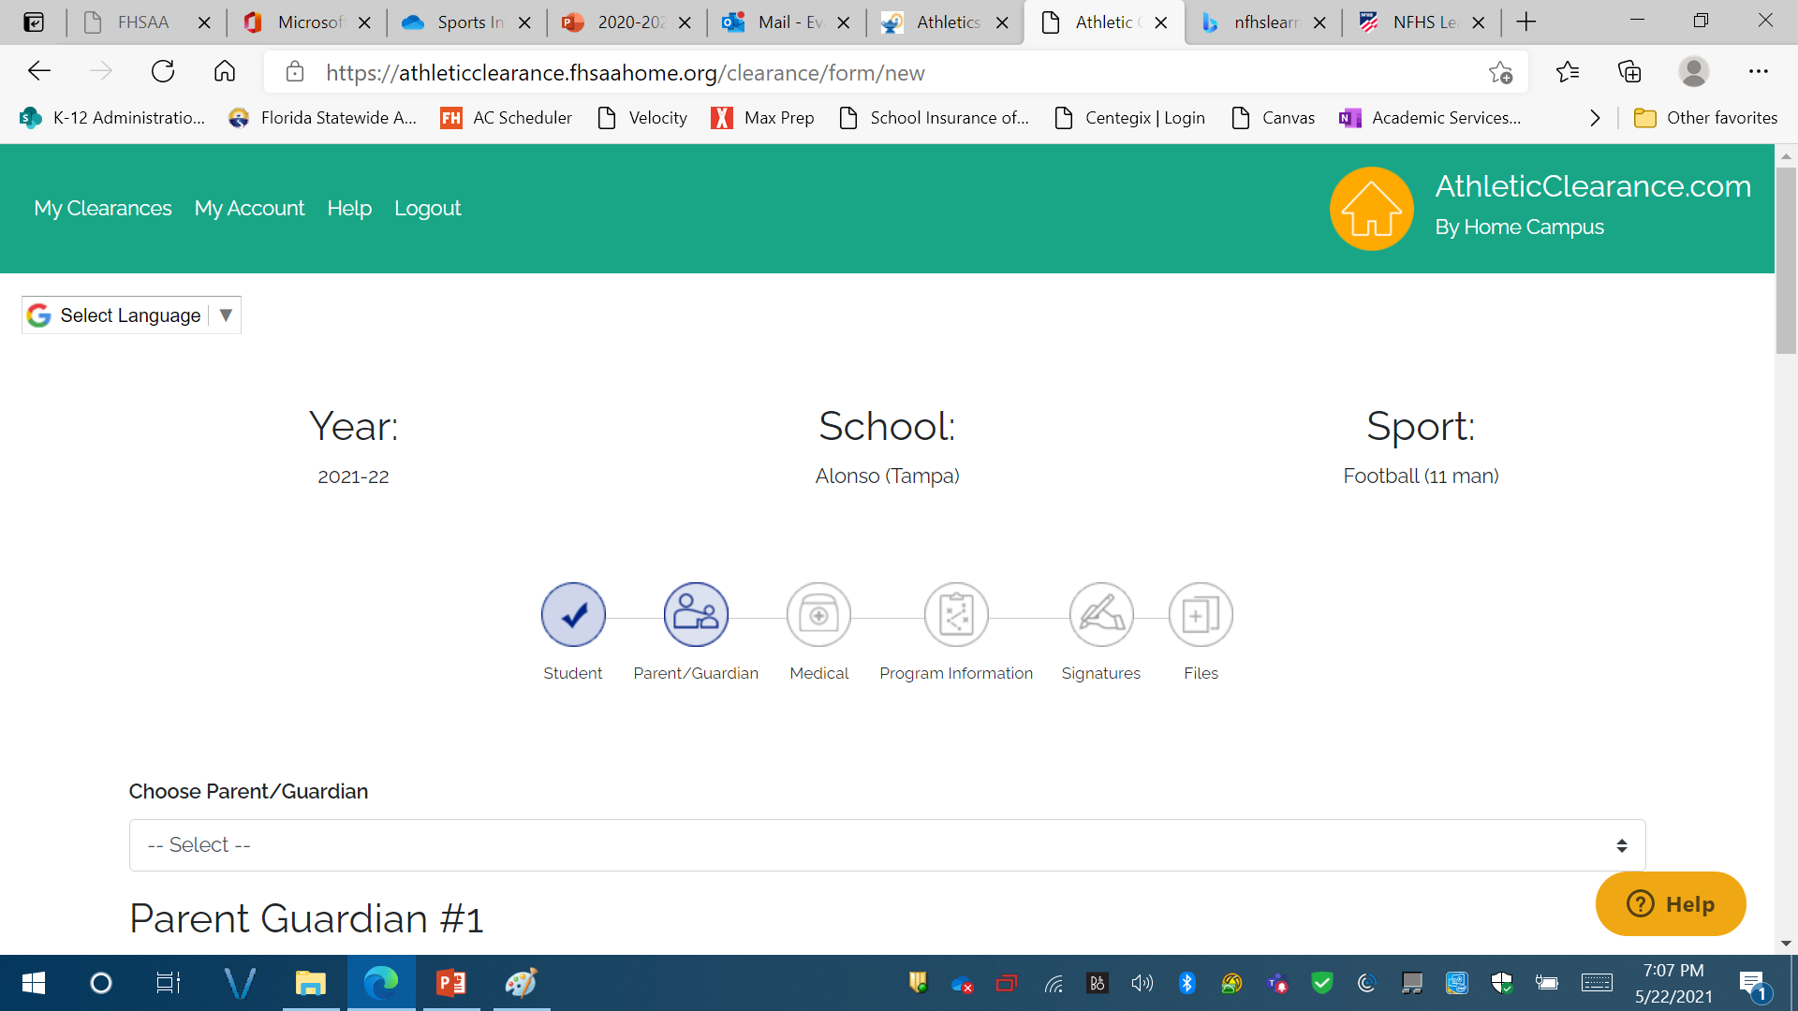
Parent guardian information – this serves as our emergency card – please be accurate
Complete Parent/Guardian Information. This SERVES AS YOUR STUDENTS EMERGENCY CARD – please complete this section with accurate information
Click on save and continue

Slide 20
Parent guardian information – this serves as our emergency card – please be accurate
Complete Parent/Guardian Information.
If you are returning student – you should be able to select your parents name from the drop down menu.
This serves as your student’s emergency card – please complete this section with accurate information
Click on save and continue

Slide 21
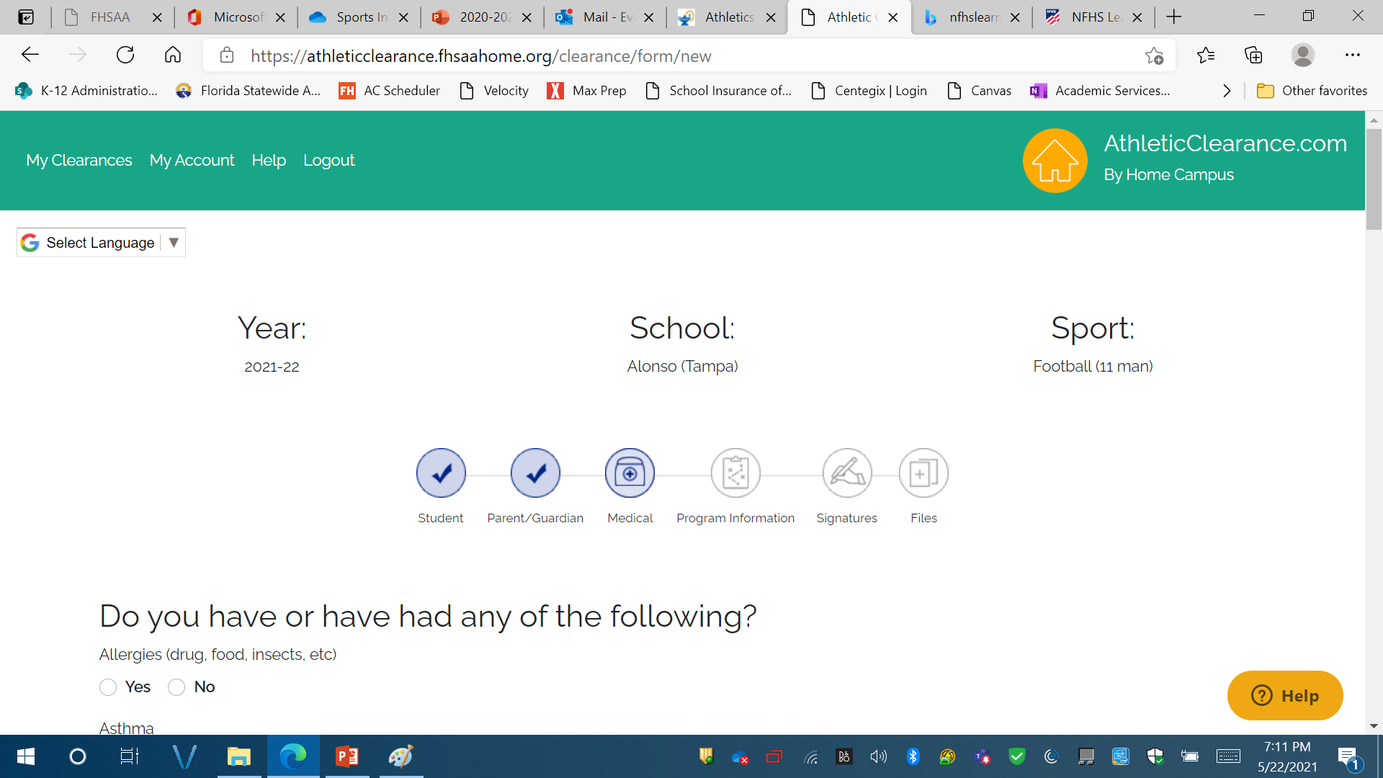
Student medical history information
This is your students medical history information.
Please complete as accurately as possible.
Click on save and continue

Slide 22
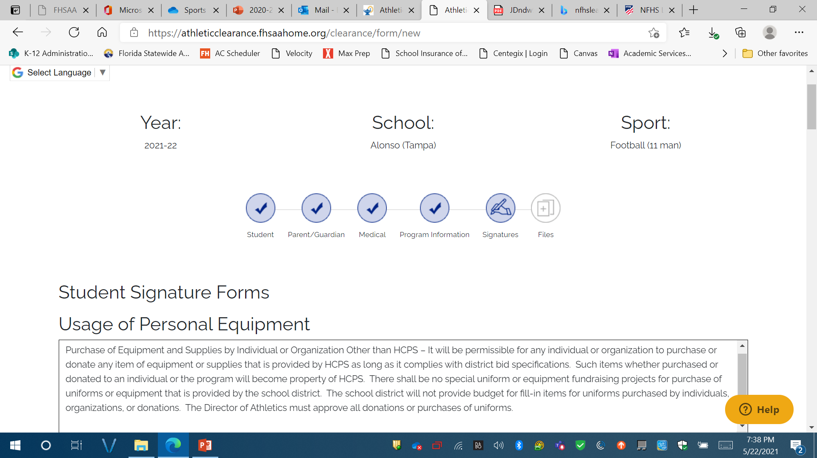
Student signature forms:
Must sign full name
Note:
IF STUDENT HAS THE SAME NAME AS PARENT SIGNING THE FORMS, DIFFERENTIANTION MUST BE MADE.
FOR EXAMPLE:
John doe, AND John doe JR.
OR
John c doe, AND JOhn S. doe

Slide 23
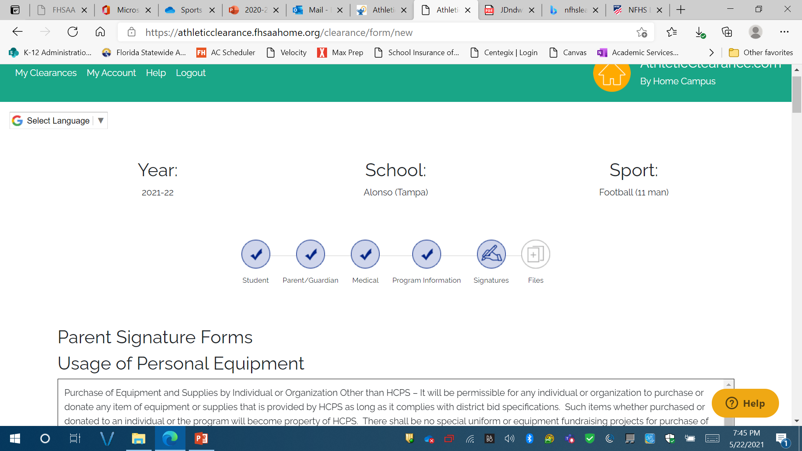
Parent signature forms:
Must sign full name
Note:
IF STUDENT HAS THE SAME NAME AS PARENT SIGNING THE FORMS, DIFFERENTIANTION MUST BE MADE.
FOR EXAMPLE:
John doe, AND John doe JR.
OR
John c doe, AND JOhn S. doe

Slide 24
Important! Read HOW TO UPLOAD FILES:
OPTION 1: USING PDF FILES TO UPLOAD
Click on choose existing files
Upload files in appropriate places.
Scroll down to the bottom of the page and click on Save and Continue.
If you have uploaded all required forms – you will receive a confirmation screen after you click on save and continue and a status of pending.
If you are missing any uploads – you will get an in processing status. If you get this screen – you are not done and I cannot see any of your documents.
OPTION 2: USING PICTURES to UPLOAD:
Click on browse
This will give you an option to take a picture
Click on Take a picture
Take a CLEAR PICTURE – DON’T CUT OFF THE EDGES OF THE PAGE. (Don’t worry about the size)
Click on Use picture.
Do this for each document that you need to upload.
Scroll down to the bottom of the page and click on Save and Continue.
You will get a confirmation screen and a status that says pending.
If you are missing any uploads – you will get an in processing status. If you get this screen you are not done and I cannot see any of your documents.

Slide 25
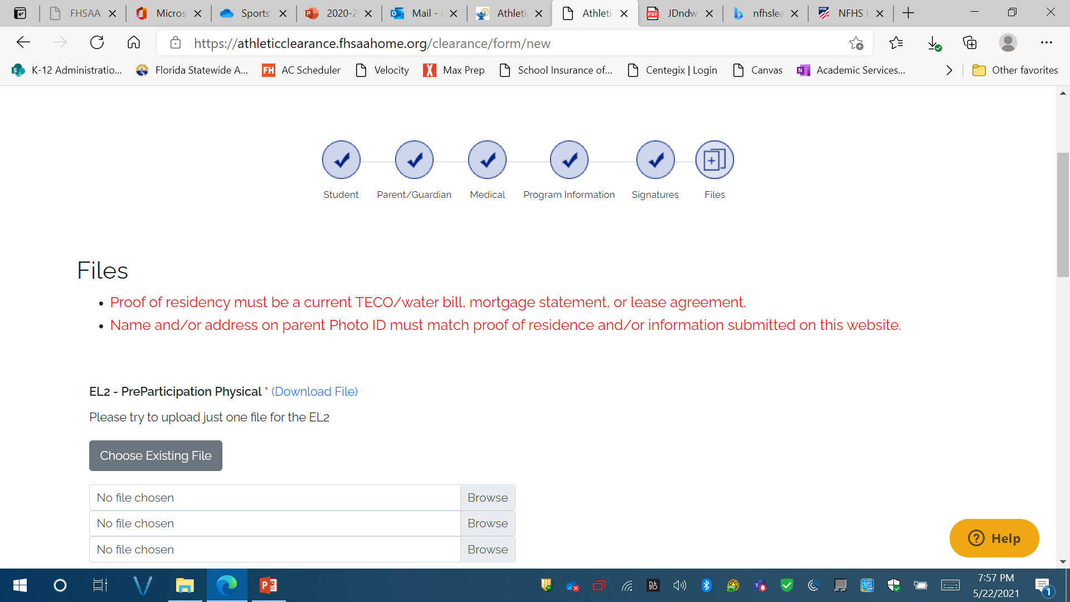
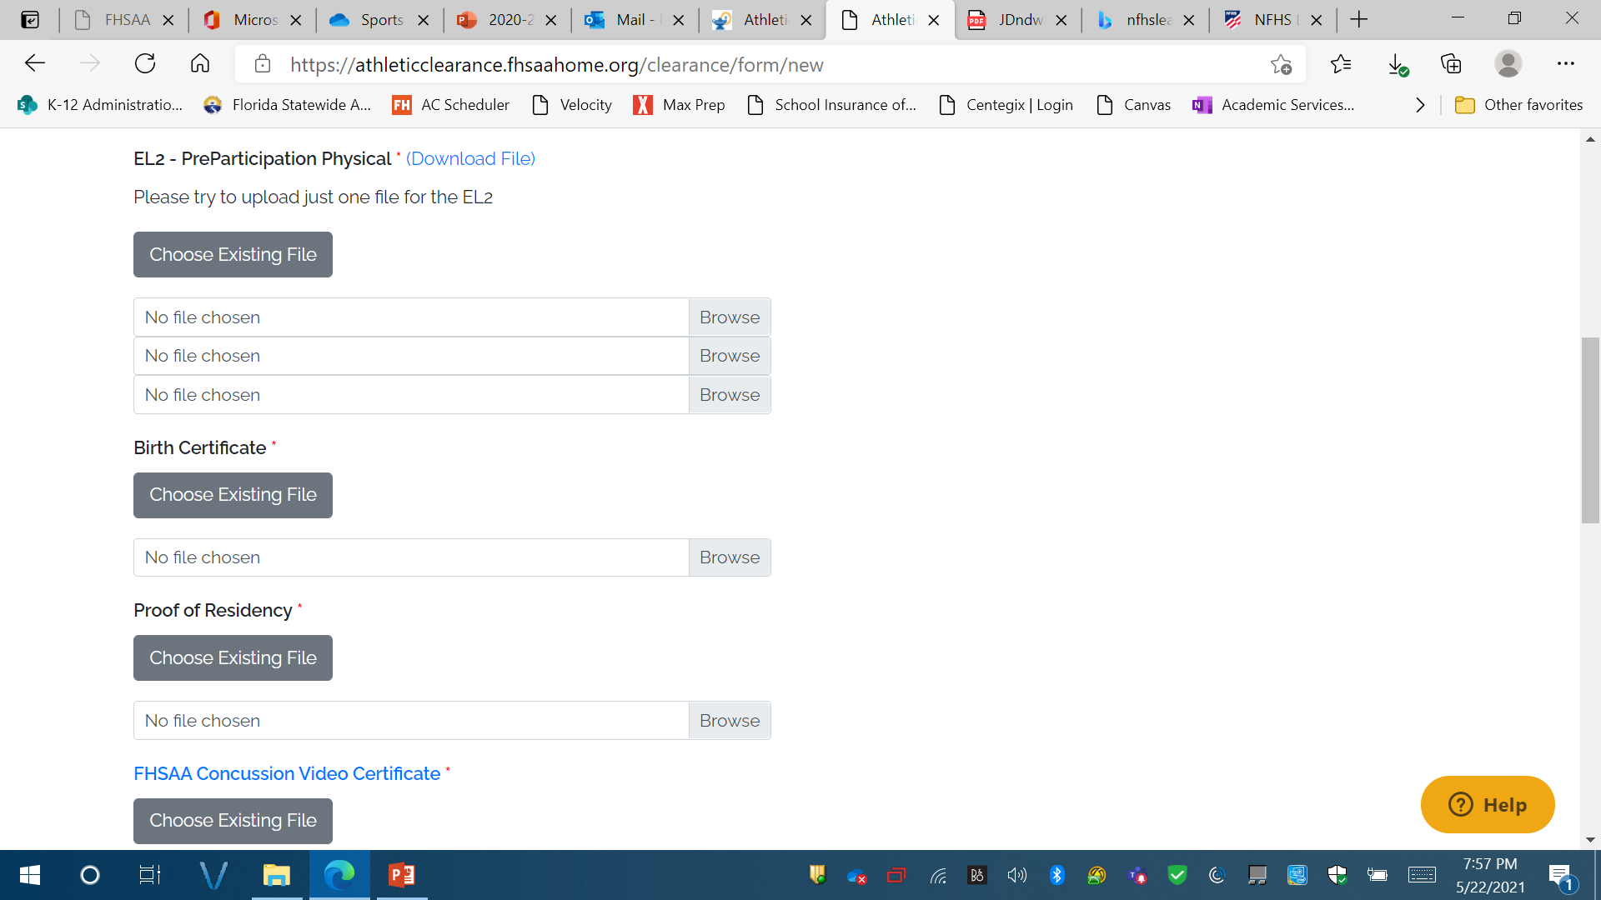
FILE UPLOADS:
EL2:
Page 4 – Must be cleared without limitation.
Doctors printed and signature MUST be on form
Doctors office address and phone number MUST be on form
Page 5: ONLY needed if recommendations were made on page 4.

Slide 26
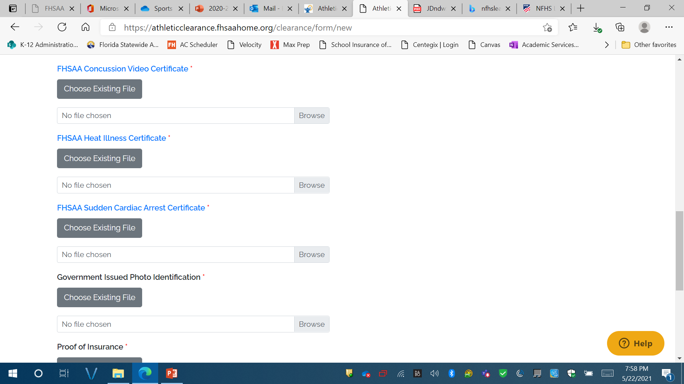
FILE UPLOADS:
NFHS Video Certificates
MUST be in STUDENTS NAME
MUST BE DATED May 15th 2023 or later for 2023-2024 school year
Concussion – to watch click on link
Heat Illness – to watch click on link
Sudden Cardiac Arrest – to watch click on link
FILE UPLOADS:
Parent signing forms Government Issued ID – DL must have matching address to student address on file at school
Scroll down and click on save and continue

Slide 27
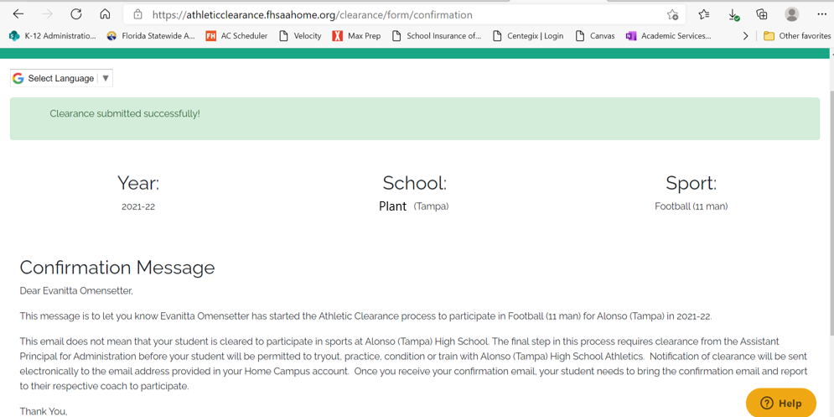

Slide 28
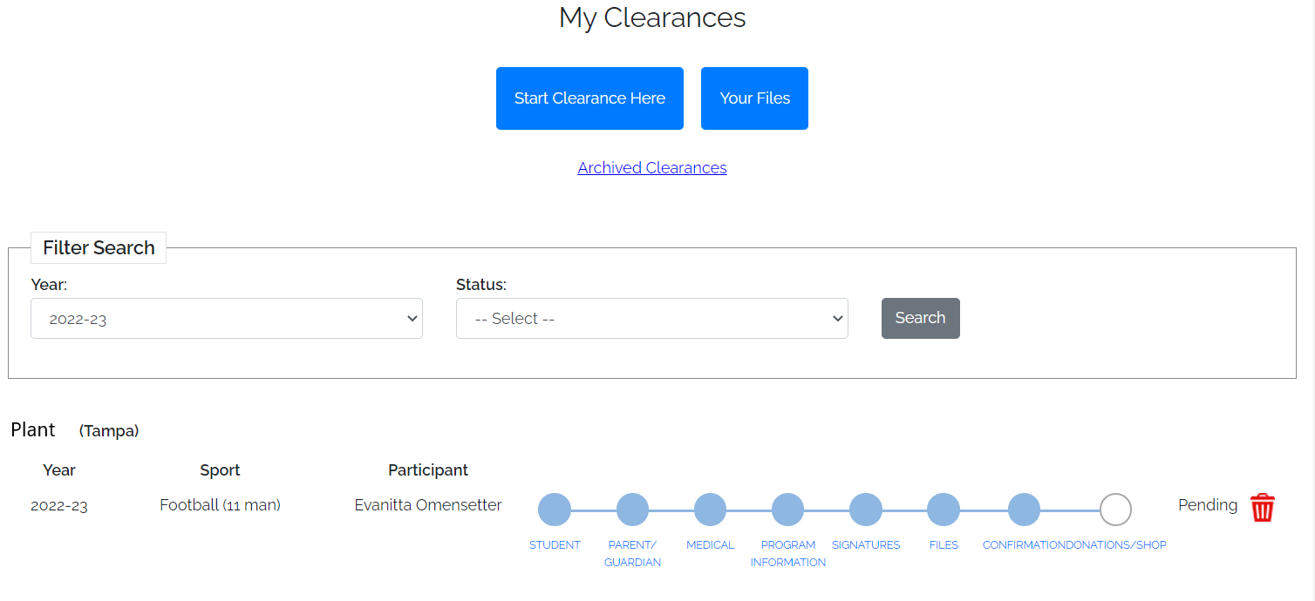

Slide 29
It can take up to 7days to be cleared. Please be patient and DO NOT wait until the last minute.
TECHNICAL ISSUES - should be directed to athletic clearance – click on the help tab and submit a ticket.
If you have any questions –
please email Dr. Jones @ chera.jones@hcps.net or students should see Dr. Jones outside of class time.

